Slide 1
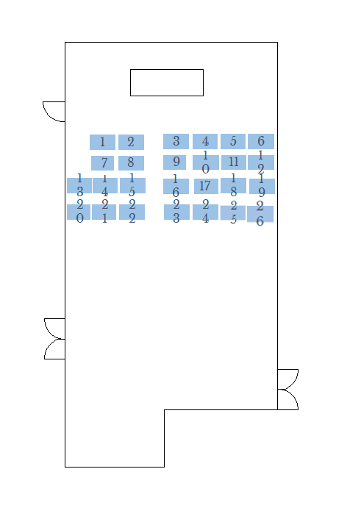
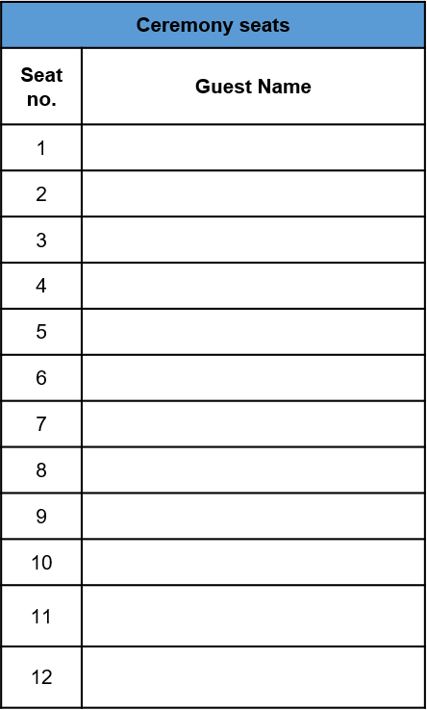
Ceremony seats
Seat no. | Guest Name
13
14
15
16
17
18
19
20
21
22
23
24
25
26
Ceremony seating plan
We would recommend that you reserve the first few rows of seating allowing space for those in your wedding party. The Best Man and anyone doing a reading will need to get out easily. You will stand for most of the ceremony and sit at the table to sign the register.

